Slide 1
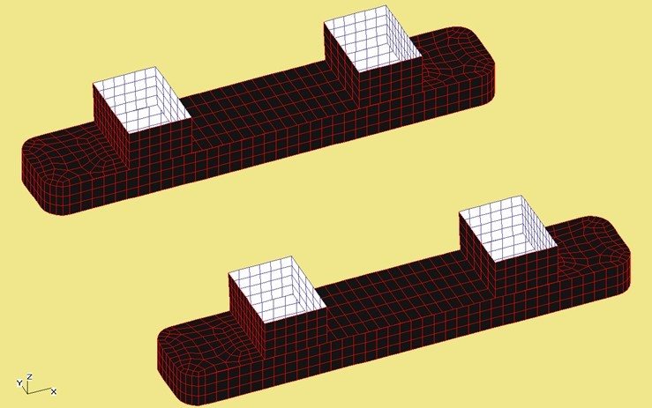
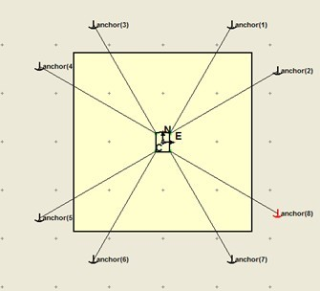
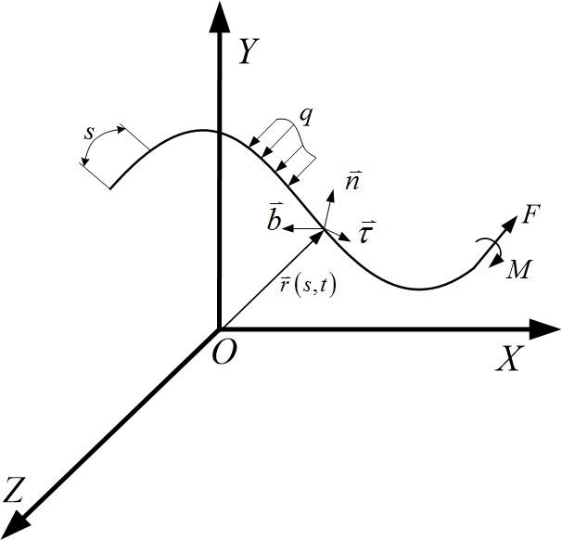
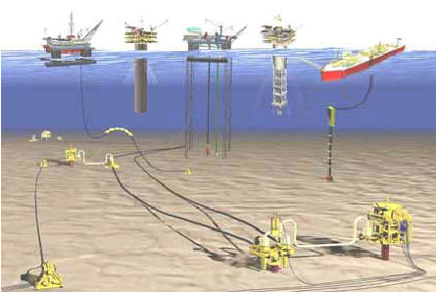
TOCS 2020
December 11-13, 2020
Study on coupled dynamic analysis of Semi-Submersible’s mooring system in South China Sea
Ting Guo
College of Mechanical and Electrical Engineering
Heilongjiang Institute of Technology
Harbin, China
gt_hljit@foxmail.com
Li Xu*
College of Mechanical and Electrical Engineering
Heilongjiang Institute of Technology
Harbin, China
112244320@qq.com
Huanqi Ye
College of Mechanical and Electrical Engineering
Heilongjiang Institute of Technology
Harbin, China
2982450852@qq.com
Shaojun An
College of Mechanical and Electrical Engineering
Heilongjiang Institute of Technology
Harbin, China
00an00@163.com
Abstract
The far-flung ocean has abundant resource and the exploitation area of ocean oil and gas is developing from offshore to deep-water and ultra-deep-water following the increase demand for oil and gas resource. Therefore, one of the floating structures for deep-water exploitation is Semi-submersible. The compute of mooring lines’ coupled dynamic analysis by using the 3-D potential theory, API of wind and JONSWAP of wave. The result indicate that the skewness coefficient and standard deviation of the mooring lines are symmetric in the N direction, so the tension on the mooring lines are relatively small, and the amplitude of the semi-submersible platform with multi-point mooring is relatively small, too.
Text
Fig. 3. The mesh model of Semi-submersible
Fig. 4. The mooring system of Semi-submersible
Since the world's first SEMI was born in 1961, the SEMI has gone through six stages of development[1-2], with operating depth form 90~180 m to over 3000 m. At present, due to the complicated conditions of ocean sea state, the hydrodynamic and mooring system performance analysis of SEMI with wind/wave/flow is the most important issue. MA et al.[3] calculate the floating platform’s coupling dynamics response based on the asynchronous coupling algorithm. Feng[4] et al. use Orcaflex software to calculate the tension response of a power generation platform based on the principle of coupled time-domain dynamic analysis. Fan[5] et al. study on the influence of three kinds of connecting constraints between the platform and mooring system. The time-domain mothed is used to solve the motion response between platform and mooring system by Kim[6]. Yang[7] et al. to solve the mooring system dynamic equation by time-domain.
Patran software developed by BV Classification Society was used for modeling. Because the NO. “981” the sixth generation semi-submersible platform of column section is divided into three sections, some pillar in the middle of the segment is wide than at both ends for semi-submersible platform provide greater buoyancy it could increase the load of semi-submersible platform. Therefore, in the process of model establishment half submerged platform for the corresponding some simplified, column section for the parametric amplification. the four corners of the floating body are rounded, The Paver divider is used to divide the grid because the four corners of the floating body are rounded and the Isomesh grid is used in the other parts of the straight wall. The total grid number of semi-submersible platforms is 2,264. Fig. 3 shows us the model of Semi-submersible.
In this section, we will give the calculation of the mooring system of Semi-submersible in South China Sea. The stress distribution of 8 mooring lines at fairlead under high-frequency and low-frequency load are as Fig. 5.
The load received by the four groups of mooring lines is almost equal with wind/wave/current load of Semi-submersible platform, that is to say, the load received by the four groups of mooring lines is uniformly distributed under the condition of following wave. However, No. 2 mooring line in the first group and No. 4 mooring line in the second group reached the maximum value at period 847s, while the other two mooring lines in the same group reached the maximum value at period 5089s. The mooring lines of the third group and the fourth group reached the maximum value at period 5084S and the minimum value at period 5089s.
The figure above shows the motion response and stress of the main modes of a Semi-submersible platform operating at a depth of 1500m. The stress at the fairlead is selected. It can be seen that the motion response of the Semi-submersible platform is relatively obvious when facing waves. Then Fig. 6 shows us the analyze by mathematical statistics.
It can be seen clearly from Fig. 6 that the mean of 8 mooring lines are consistent surprisingly, the average value is 6921 KN. From the skewness coefficient the line 1 and the line 3, line 2 and line 4, line 5 and line 8, line 6 and line 7 are equal, because they are symmetric in the N direction.
The standard deviations are great difference, while the mean are consistent. It can be seen that the maximum of standard deviations are line 6 and line 7, numerical value reach 46.987, it means the curve fluctuates greatly, the amplitude of fluctuation differs between the maximum and the minimum reach 5.5%.
In terms of standard deviation the grouping trend of 8 mooring lines is still symmetric in the N direction. There are similar trends between line 1 and line 3, line 2 and line 4, line 5 and line 8, line 6 and line7.
CONCLUSION
The tension on the mooring lines are relatively small, because of multi-point mooring semi-submersible platform’s mooring lines share the buoyancy force, wave force and second-order wave slow drift force of the semi-submersible platform. It can quickly recover to the stable state, when the semi-submersible platform encounters large displacement or heavy load, which increases the stability of the platform working under harsh environment. The amplitude of the semi-submersible platform with multi-point mooring is relatively small, which is more conducive to its drilling work.
Fig. 1. The classic floating structures
Fig. 2 the schematic diagram of the slender rod model

