Slide 1
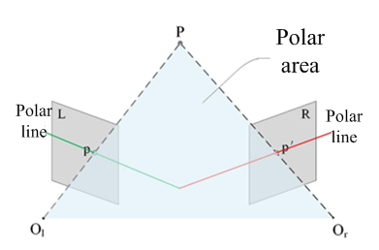
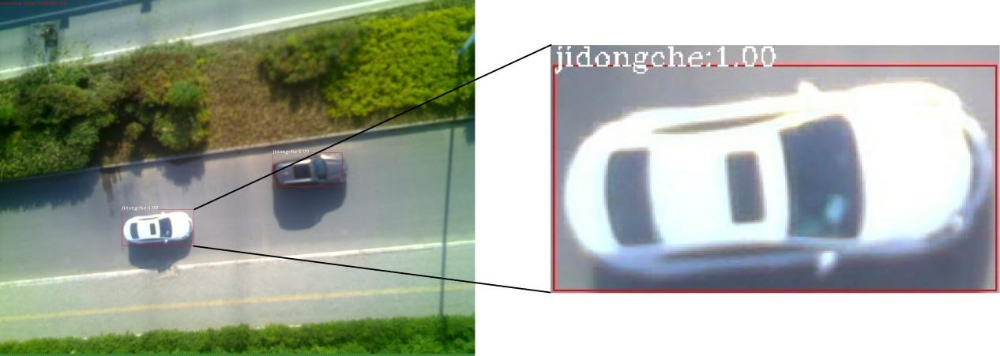
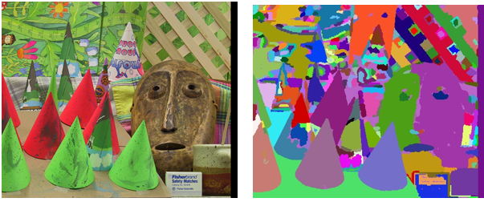
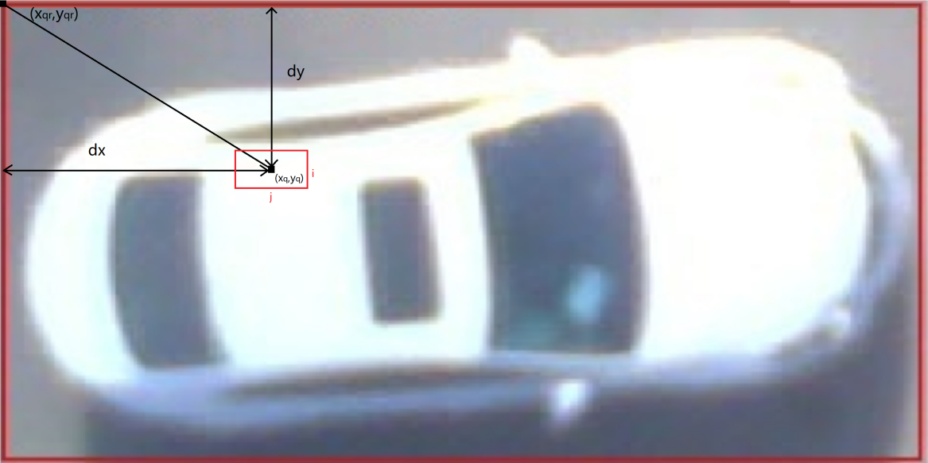
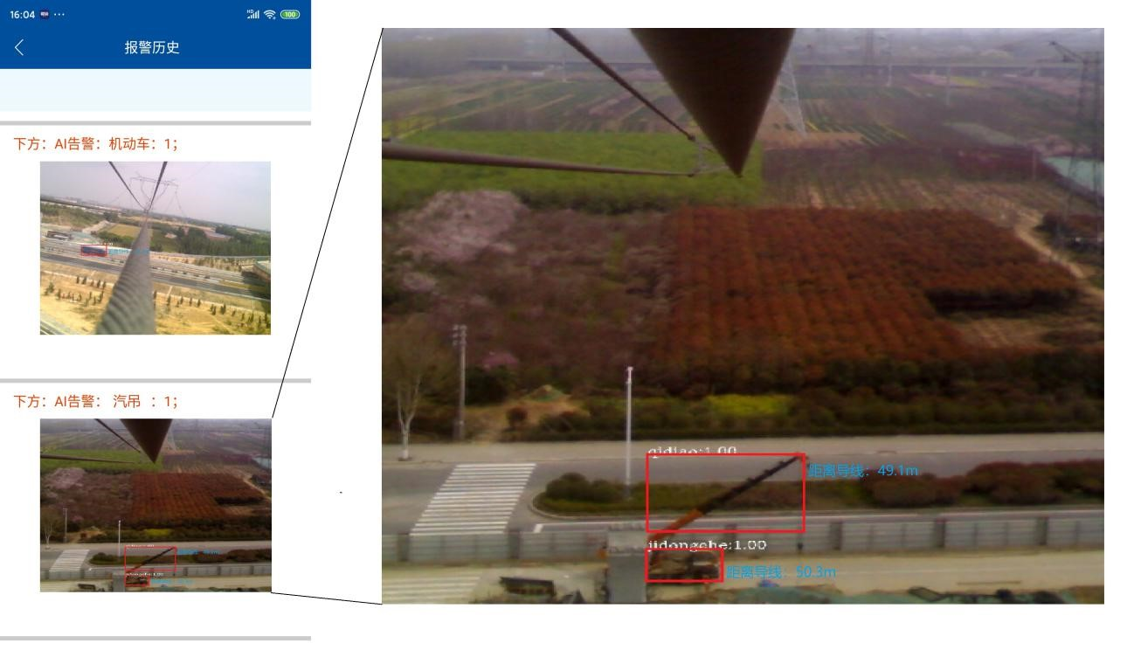
TOCS 2020
Shenyang, China December 11-13, 2020
The research on binocular ranging technology for transmission lines based on two - dimensional line matching
Qinglong Ma
Yunnan Power Grid Co., LTD. Zhaotong Power Supply Bureau
Zhaotong, Yunnan 657000, China
Abstract
using binocular distance measurement technology to obtain the distance between the dangerous object and the transmission line, which provides powerful data information for the judgment of the risk degree of external damage and the assessment of the probability of the line suffering from external damage, so as to ensure the safety of the line. In order to solve the problem of large epipolar error caused by serious image distortion under wide-angle lens, local two-dimensional line matching scanning technology, which based on the object position information obtained by target detection, reduced the influence of epipolar error and increase the robustness of matching. At the same time, the dense calculation of global image distance is degraded to the local dense calculation of target, which improves the real-time performance of binocular ranging algorithm in high-resolution monitoring image. Finally, the image segmentation technology is used to improve the mismatching problem at the depth discontinuity to further improve the accuracy of binocular ranging.
Text
With the development of social economy, the total mileage of transmission lines in China is increasing. By 2018, the total length of 35kV and above transmission lines in China has reached 1.892 million kilometers, ranking first in the world. However, with the increase of transmission line length, the risk of external damage is also increasing, especially in some "three span" environment. Once the transmission line accident occurs, it will have a significant impact on the surrounding systems and economy. In recent ten years, with the development of artificial intelligence technology, more and more equipment equipped with real-time monitoring and image recognition technology appear in the transmission line monitoring system [1,2]. Through the real-time acquisition of transmission line surrounding images and video information, artificial intelligence technology realizes the early warning of external damage [3,4]. However, artificial intelligence technology only provide target category and position information on the image, and can not further obtain important information such as the distance between dangerous objects and transmission lines. Therefore, it needs to be realized with the help of multi domain technology of comprehensive image recognition.
As shown in Figure 3, in order to improve the clarity of the image and expand the monitoring range, the resolution of the image is gradually improved. At present, high-resolution lens is widely used in the actual monitoring environment. In the process of monitoring and early warning, there are a large number of background areas without calculation reference meaning, namely non target areas. In most cases, the objects with the danger of external destruction occupy only the small area of the image, namely the two red box areas in Fig.3. Under this background, the local density calculation of the target is used to replace the global density calculation of the image to improve the calculation speed. Because the two-dimensional matching scanning needs to rely on the relative position relationship between the rectangular box and the pixel, the local dense calculation of the target is more in line with the characteristics of two-dimensional line matching.
Fig.5 is the experimental picture of the actual production environment scene, the left side is the alarm information of the monitoring device app terminal, and the right side is the enlarged version of the lower left alarm picture. It can be seen that on the basis of target detection, combined with binocular ranging technology, can not only obtain the location category information of the target, but also quickly and accurately obtain the distance from the object to the transmission line.
Fig.1 Epipolar geometry model
Fig.3 Actual monitoring environment
Fig.4. Mean shift segmentation image
Fig.2 Calculation of scanning area using relative position information
Conclusion
Fig.5 The actual scene effect
This paper proposes a method to improve the accuracy and robustness of binocular ranging based on two-dimensional line matching scanning technology. This method relies on the position and size information of the target obtained by the target detection technology. Without reducing the matching scanning speed, the two-dimensional line matching scanning is used instead of the single line matching scanning, so as to reduce the false matching probability caused by the serious image distortion. At the same time, because the monitoring image is only interested in dangerous objects, the global dense calculation of the image distance is degraded to the local dense calculation of the target, so as to improve the speed of binocular ranging in high-resolution images.

